Slide 1
Introduction To Information And Communication Technologies
Lab-1
Notes:
ID=d924773e-9a16-4d6d-9803-8cb819e99682 Recipe=text_billboard Type=TextOnly Variant=0 FamilyID=AccentBoxWalbaum_Zero

Slide 2
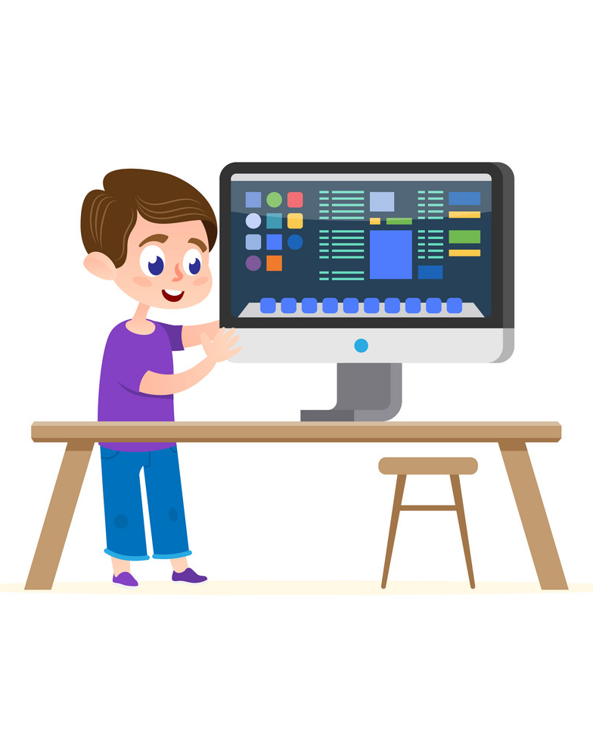
About Course
Course Code : CL1000
Title : Introduction To Information And Communication Technologies
Pre-req : None
Credit hours : 0 + 1
LMS : Google Classroom

Slide 3
About Instructor
Name : Qurrat Ul Ain
Experience : 4+ years
Email : i220727@nu.edu.pk

Slide 4
Class Rules
No attendance after 15 minutes.
Use of mobile phone is strictly prohibited.
Noise/Distribution not allowed.
Commenting on peers is strictly forbidden.
No Quiz/Assignment retake.
No late Submission allowed.
Plagiarism in project or midterm/ final exam may result in F grade in the course.
Plagiarism in an assessment may result in zero marks in the that particular assessment.

Slide 5
Assessments & Grading
Grading policy : Absolute
Assessment Item | Number | Weight (%)
Assignments | 1 | 10
Lab Task | 10 | 15
Presentation | 1 | 15
Project (Lab) | 1 | 20
Final Exam | 1 | 40

Slide 6
What is Computer?

Slide 7

Basic Definition:
A computer is normally considered as calculating machine that can perform arithmetic operation at a very high speed.
Computers are electronic devices that is programmed to
accept data (input),
(process) that data into useful information,
produce (output), and then
(store) for later use.

Slide 8
But….
You may already know that you can use a computer to type documents, send email, play games, and browse the Web.
You can also use it to edit or create spreadsheets, presentations, and even videos.
Computers come in many shapes and sizes, and they perform many different functions in our daily lives. When you withdraw cash from an ATM, scan groceries at the store, or use a calculator, you're using a type of computer.

Slide 9
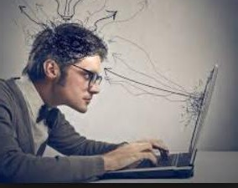
Someone who communicates /interacts with a computer.
WHO IS USER?

Slide 10
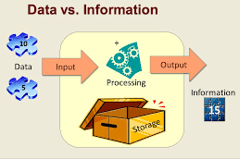
DATA & INFORMATION
DATA
A collection of raw facts and figures is called data.
It may consist of numbers, characters, symbols etc.
INFORMATION
Processed data is called information.
It is more meaningful than data

Slide 11
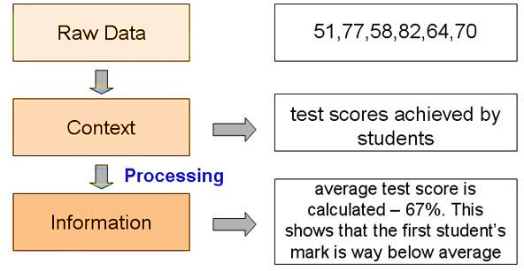
Data & Information (Cont..)

Slide 12
Software
Its a collection of computer instructions that tell the computer how to work.
Application Software
System Software
Uses the computer system to perform special functions or provide entertainment functions beyond the basic operation of the computer itself.
It directly operates the Computer Hardware, to provide basic functionality needed by users and other software, and to provide a platform for running application software.

Slide 13
COTS vs Custom built software

Slide 14
COTS vs Custom built software
COTS software is designed to meet the generic needs of various business processes.
Custom built software applications are built to effectively cater to specific needs for your business—and as your business grows.

Slide 15
Information Technology
Information is data that is organized, meaningful, and useful.
Information technology is the use of systems (especially computers and
telecommunications) for storing, retrieving, and sending information.
Computer is a very important component of information technology

Slide 16
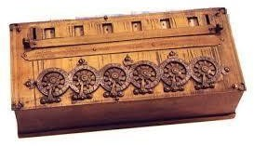
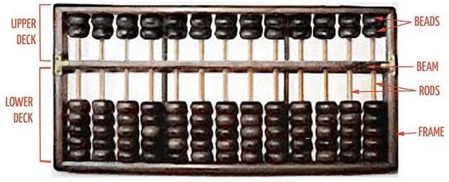
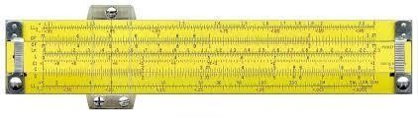
Mechanical Computers (1600 – 1900)
Pascal
Calculator
Abacus
Slide Rule

Slide 17
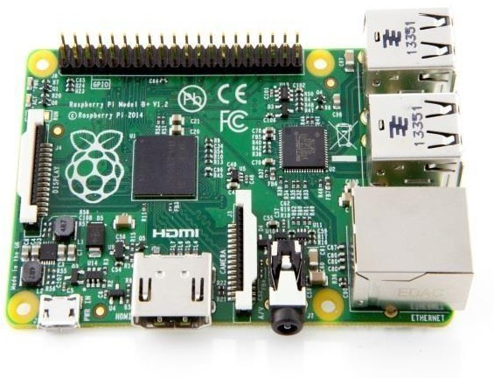
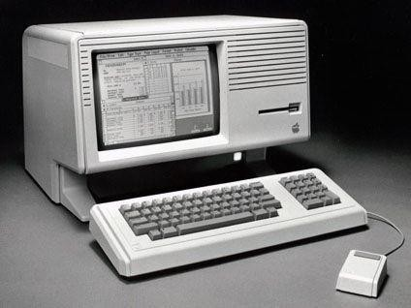
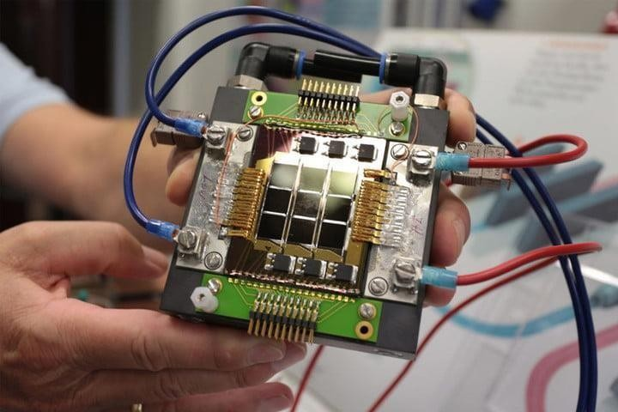
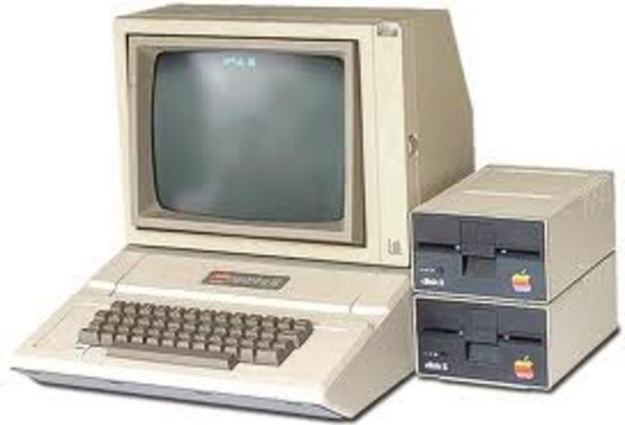
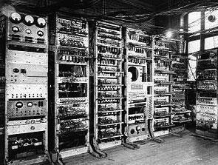
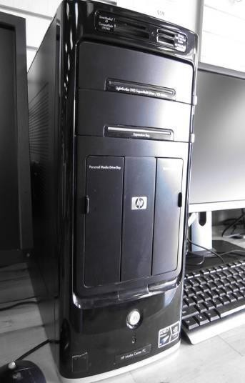
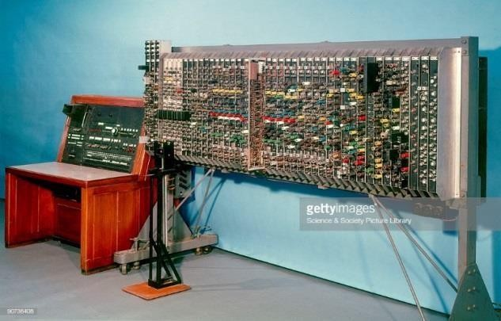
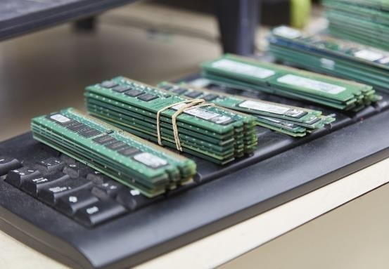
Electronic computers (1937 - 1953)

Slide 18
Evolution of Computers
First Generation of Computers (1942 - 54) : Vacuum Tubes
Second Generation Computers (1952 - 1964) : Transistors, Magnetic core, Fortran ,COBOL
Third Generation Computers (1964 - 1972) : Integrated Circuits, Fortran II to IV
Fourth Generation Computers (1972 – 1990) : VLSI, C, C++
Fifth Generation (1990 - Present) : Artificial Intelligence+ ULSI
Sixth generation (Future)

Slide 19
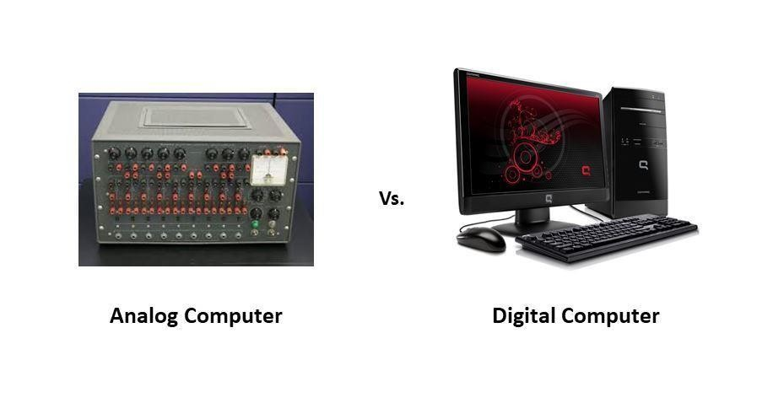
Types of Computers
Analog Computers
Digital Computers

Slide 20
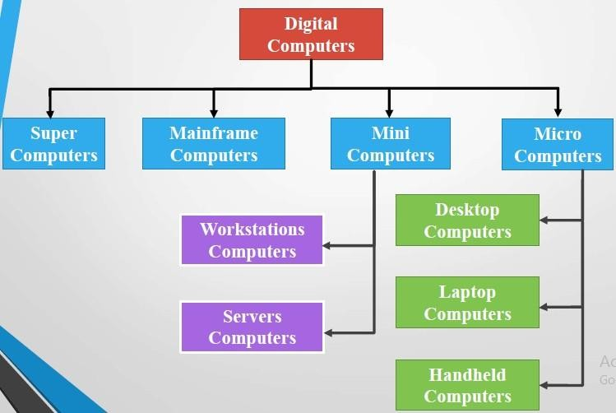
Classification of Computers

Slide 21
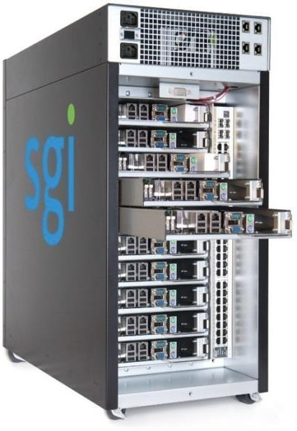
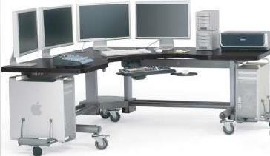
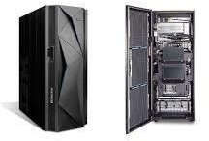
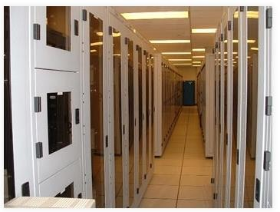
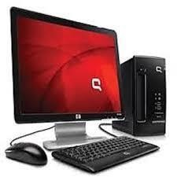
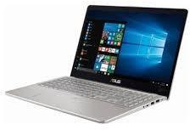
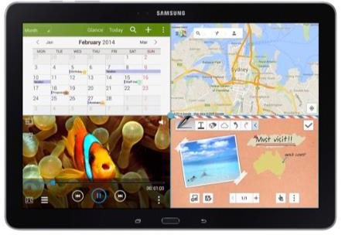
Classification of Computers
Mainframe Computers
Workstation
Super Computers
Server
Desktop
Laptop
Tablet

Slide 22
Other Types of Computers
Smartphones: Many cell phones can do a lot of things computers can do, including browsing the Internet and playing games. They are often called smartphones.
Wearables: Wearable technology is a general term for a group of devices— including fitness trackers and smartwatches—that are designed to be worn throughout the day. These devices are often called wearables for short.
Game consoles: A game console is a specialized type of computer that is used for playing video games on your TV.
TVs: Many TVs now include applications—or apps—that let you access various types of online content. For example, you can stream video from the Internet directly onto your TV.

Slide 23
Modern Applications
Computers have been used over the years in following areas:
Business
Education
Entertainment
Banks
Hospitals
Information
Communication
Etc….

Slide 24
Modern Applications
In almost every second of our lives we are interacting with computers :
Amazon Alexa
Humanoid Robots(Sophia)
Augmented Reality
Driver less cars + Navigations
Wars (Drone)

